Slide 1
Siskiyou County Planning Commission
Kidder Creek Orchard Camp
January 18, 2023

Slide 2
December 13, 2022, Board of Supervisors Meeting
The Board unanimously voted to send the project back to the Planning Commission for further deliberation.

Slide 3
Areas of Concern
Fire Hazards
Pond
Zoning
Biological Resources
Mitigation Monitoring Reporting Program (MMRP)

Slide 4
Fire Hazards
Concern
Response
Patterson Creek and the proposed escape routes circle back to the direction of Cheeseville.
An analysis of fire behavior is warranted.
Any road to be constructed in excessive slope areas be constructed to protect against erosion.
The ability of the camp to utilize Project Activity Levels (PALs).
Public Resource Code Section 4290 standards speaking to signage for evacuations, storage water requirements, and greenbelt requirements.
KCOC will utilize any and all routes dependent upon emergency and the direction of travel of staff and guests are able to go, including an alternative route to the north.
KCOC has already completed fire behavior analyses. Bryan Schenone has completed additional analysis, per request.
Any road will be constructed to protect against erosion.
The Camp will utilize PALs.
The Camp currently meets all requirements of 4290 and will make any additional improvements if required by Cal Fire or the County.

Slide 5
Pond
Concern
Response
Review whether the proposed pond requires downhill channeling from Barker Ditch and thus is not only a pass-through but a diversion.
Review the evaporation study by Chris Cummings related to the methodology used.
Whether or not the “leaky ditch” regulation would result in curtailment of Barker Ditch in the future. Given these considerations, would the project have a reduced number of participants at any given time if there is no pond?
Is there a need to condition that wells are for domestic use only?
The decision as to whether the channeling from Barker Ditch to the proposed pond should be classified as a diversion is a legal determination for the California State Water Board, though it arguably appears that the secondary channel could be classified as a diversion under Water Code Section 5100(c).
Chris Cummings will provide additional clarity on the study.
The Deputy Director for the division of Water Rights may now issue a curtailment order when flows of certain rivers, including the Scott River, drop below certain minimums unless diversions from the river are curtailed.
Any well permit applications must make the selection of use for the well for which they apply for. If KCOC applies for and receives a permit for the domestic designation, the use of the groundwater is by virtue of the permit issuance for designated for domestic uses.

Slide 6
Zoning
Concern
Response
Is the density of the recreation taking place at the camp and whether that level of recreation should be considered “commercial”.
All recreational uses are governed under County Code 10-16.1502.
Section 10-6.3602.58 defines “recreation facility, private” as a recreation facility operated by a non-profit organization and open only to the bona fide members and guests of such non-profit organization.

Slide 7
Biological Resources
Concern
Response
Concerns were raised that the Biological Resources assessment did not include the Northern Spotted Owl or Bald Eagle.
Both species are identified in the amended Wildlife Resources Report and the Wildlife Resources Biological Assessment for the emergency road access port prepared by Jamie Allen.

Slide 8
Mitigation Monitoring and Reporting Program (MRRP)
Concern
Response
There was a concern raised that the MMRP was not included for review and approval during the November Planning Commission meeting.
Although not legally required, Staff has incorporated the MMRP into the staff report package for review and approval.

Slide 9
Fire Behavior Analysis

Slide 10
Mitigation
Mitigation is a key element that KCOC has obligated to ensure the safety of the property through compliance with the State Fire Code 4290.
Adhering to the road standard and defensible Space and ongoing fuel mitigation project IAW 4290.3.
Our analysis compliance of mitigation IAW 4290.1, the compliance of High Severity Zone in a mountainous region meets and exceeds the intended standards. SV Fuel Reduction Plan.

Slide 11
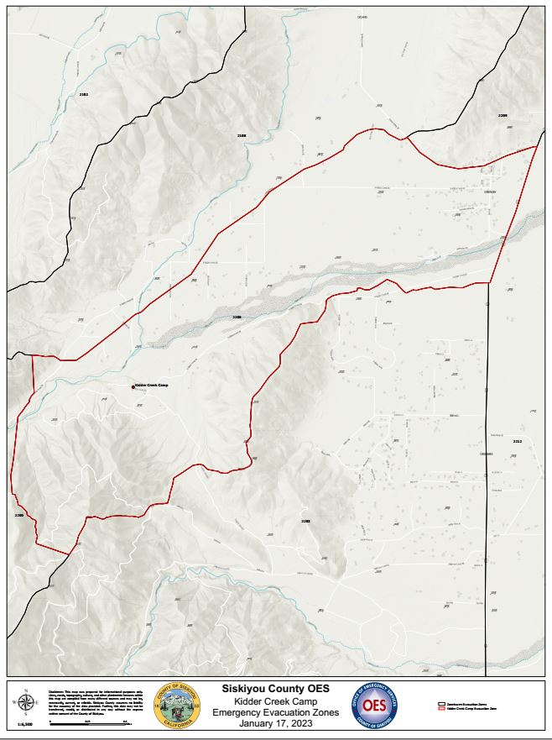
Warning and Alert System (WAS).
OnSolves/ CodeRED alerting system for all evacuation warnings
OES will send an Integrated Public Alert & Warning System (IPAWS) alert for every evacuation order
  transmit a forced alert to all receivers and broadcast

Slide 12
Warning & Alert
Kidder Creek is within the zone: SIS-2206,
  Public facing as Zones populate with yellow for a warning and red for an order base on the public-facing map the integration of CodeRED, IPAWs, and ZoneHaven alerting.

Slide 13
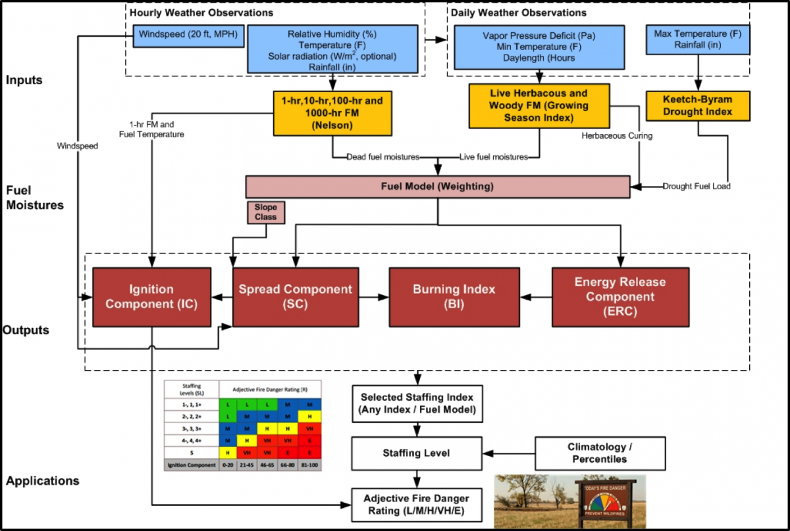
Requested Project Activity Level (PAL)
Project Activity Level (PAL) is a decision support tool designed to help fire and timber resource managers establish industrial precaution level for the following day.
KCOC has been made aware of the system to ensure decision-making points that can be addressed as the condition's severity increase.
Region 5 - Management (usda.gov)

Slide 16
Recommendations
Ready: Establish designated Evacuation routes within the Camp leading to a designated Temporary Evacuation Point (TEP) and post reflective evacuation signage along the egress routes, both pedestrian and vehicular, designate a colored vehicle evacuation process.
Set: Practice and coordinate a KCOC evacuation drill Pre-Fire Season with an after-action report to identify the strengths and opportunities.
GO: Evacuate Early.
  Based on the models produced by the CalFire Prevention team
  Evacuation times vary
    If a wildfire remotely threatens that Camp to evacuate while in a Warning
    Implement Alpha Plan, allowing time to Evacuate the Remaining animals if an evacuation Order is placed

